Slide 1
Lab 5: Introduction to RNNs
University of Washington
EE 596/AMATH 563
Spring 2021

Slide 2
Outline
Sequential Data
Intro to Recurrent Neural Networks (RNNs)
Challenges with RNNs
Example: Sine Wave Generation
Assignment: Cosine Waves
Notes:
Today, we will discuss the implementation of RNNs.
We will start by discussing some types of sequential data and sequential modelling tasks
We will then introduce the Recurrent Neural networks (RNNs) and how to implement them in PyTorch
I will then address some of the challenges associated with training RNNs on sequential data
Next, I will go over an example RNN implementation generating sine waves
Finally, we will go over the assignment for this week

Slide 3
Sequential Data
Notes:
We will start with discussing sequential data

Slide 4

Example Sequential Data and Tasks
Written Language
Character Prediction
Machine Translation
Audio
Speech Processing
Music Transcription
Spatio-Temporal Data
Body capture data
Weather modelling
Neurological Models
Language Modelling/Prediction
هوا امروز چطوره؟
“What is the weather today?”
Machine Translation
Notes:
Sequential data is prevalent in many different forms and tasks. Some examples of sequential data include:
Written language.
With written language, a sequential model may need to predict character or words from previous input (like an autofill feature)
A model can also be trained to translate from one language to another.

Slide 5
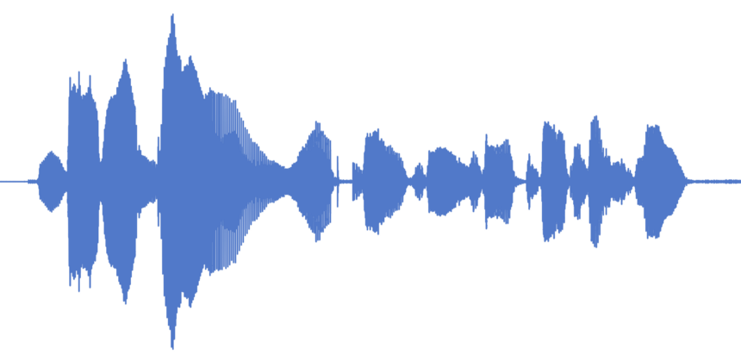

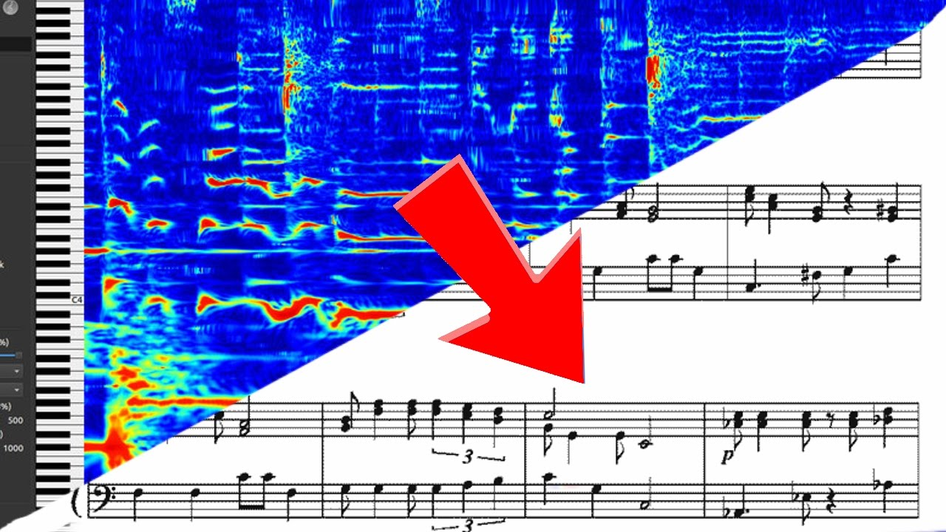
Example Sequential Data and Tasks
Written Language
Character Prediction
Machine Translation
Audio
Speech Recognition
Music Transcription
Spatio-Temporal Data
Body capture data
Weather modelling
Neurological Models
“Hey Google, what is the weather today?“
Speech Recognition
Music Transcription
Notes:
Another common form of sequential data is audio.
Audio processing tasks can include speech recognition, such as in smart speakers, or transcribing sheet music from source audio.

Slide 6

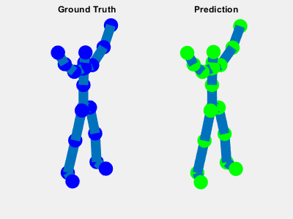
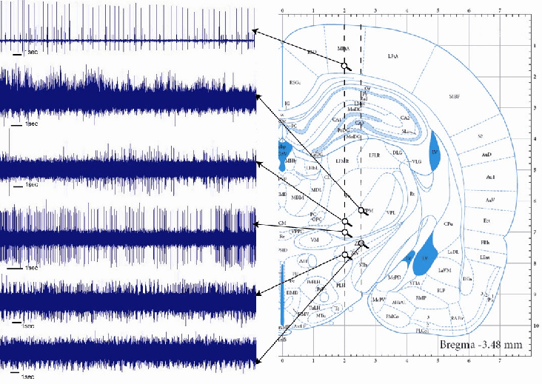

Example Sequential Data and Tasks
Written Language
Character Prediction
Machine Translation
Audio
Speech Recognition
Music Transcription
Spatio-Temporal Data
Body capture data
Weather modelling
Neurological Data
Body Motion Capture
Brain Activity
Weather Modelling
Notes:
In the sciences, data collection often contains information about both time and space.
Some such applications include body motion capture, weather modelling and forecasting, and neurological modelling.

Slide 7

Features of Sequential Data
Order matters
Unlike a group of vectors, the order in which data appear in sequential data is important
Variable length
Measurements are not always captured over the same number of time-steps
Temporal dependence
Previous data values usually has impact on current value
Notes:
Sequential data is different from vector data in a variety of ways. These differences pose additional challenges and considerations when working with sequential data.
Firstly, the order of data in a sequence matters. Words or characters placed in random order have no meaning. It is therefore important to retain this knowledge of the order when building networks.
Sequences can also vary in terms of how many time steps over which data samples are collected. Regardless of the length of the input, trained sequential models should be able to make predictions.
The key assumption for sequential data is that there exists temporal dependency between inputs. In other words, the value of the data at previous time steps will determine the value at the current and later time steps. However, the number of time steps that this dependency extends to varies by data and application.

Slide 8
Recurrent Neural Networks
Notes:
The Recurrent Neural Network (RNN) specializes in processing sequential data. I will show you how to implement an RNN using pytorch and various settings available when setting one up.

Slide 9

RNN Setup
Processes input (x) at each step using shared parameters (A)
Retains memory by evolving the hidden state (h) as a function of input
Image Source: Colah’s Blog
Notes:
The RNN processes sequential input (x) at each time step using the same shared parameters (represented by A in this figure). The memory of the previous input is stored using the hidden state, h. This hidden state is stored within the RNN cell (represented by a green box) and is carried over across time steps. It is also the output of the network.

Slide 10
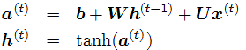
RNN Setup
Output of a cell is the hidden state h^{(t)}
Function of input (x) at time t and previous hidden state
Notes:
The equations for an RNN are shown here. The input x^t and the previous step’s hidden state h^(t-1) are each multiplied by separate parameters, U and W, respectively. Additionally, you can have a bias term b which is added to these terms.
The output of an RNN cell is the hidden state, which you get by inputting the argument a into the non-linear activation function (tanh in this case).

Slide 11
RNN Implementation
torch.nn.RNN()
Parameters
input_size
hidden_size
num_layers
nonlinearity
bias
batch_first
dropout
bidirectional
Notes:
When creating an RNN in PyTorch, there are many settings which you can control. We will go over each of these over the following slides.

Slide 12
RNN Implementation
torch.nn.RNN()
Parameters
input_size
hidden_size
num_layers
nonlinearity
bias
batch_first
dropout
bidirectional
Input size is the dimension of the input at each time step.
The size of each vector in a sequence
Hidden size is the dimensionality of the hidden state, h.
The number of neurons processing each time step
Notes:
The input size indicates the dimension of the input data at each time step. In other words, if the input at each step of a sequence is a vector, the input_size should be the dimension of that vector
The hidden size is the dimenionsality of the hidden state of the RNN cell. This determines the number of neurons used to process input and store memory.

Slide 13
RNN Implementation
torch.nn.RNN()
Parameters
input_size
hidden_size
num_layers
nonlinearity
bias
batch_first
dropout
bidirectional
Num_layers is the number of stacked RNN layers (default: 1)
Will be covered in detail in Lab 6
Non-linearity is the activation function for the neurons
Choice of `tanh` or `relu` (default: tanh)
Notes:
num_layers determines the number of stacked RNN layers there are in the RNN. Stacked RNNs treat the output of the previous layer as the input of the next layer at each time step. The default for this setting is 1. We will discuss multi-layer RNNs in greater detail in lab 6.
nonlinearity determines the nonlinearity used in the RNN cell. The options are tanh and relu. If you do not specify this setting, the default will be tanh.

Slide 14
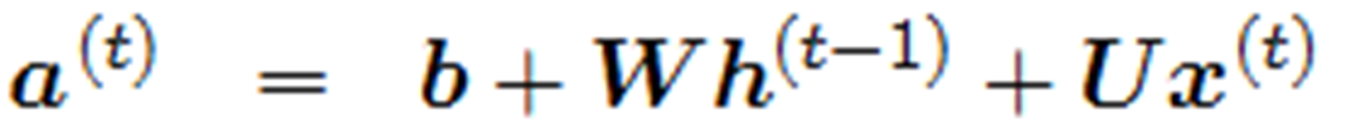
RNN Implementation
torch.nn.RNN()
Parameters
input_size
hidden_size
num_layers
nonlinearity
bias
batch_first
dropout
bidirectional
Bias is a Boolean indicating whether to include the bias term (b) in the neuron (default: True)
Batch_first indicates whether the first dimension of the input is the batch- (batch, seq, feature)
Default: False – (seq, batch, feature)
Notes:
Bias is a Boolean indicating whether a bias term (b in the equation below) is added to the Tensor products of the RNN cell. The default value is True.
batch_first tells the network whether the input data will have the first dimension be the batches instead of sequence (i.e., time step). If true, the order of the input data dimensions should be (batches, sequence steps, features). If false, the first two dimensions are flipped such that time is varied along the first dimension. The default value is False.

Slide 15
RNN Implementation
torch.nn.RNN()
Parameters
input_size
hidden_size
num_layers
nonlinearity
bias
batch_first
dropout
bidirectional
Dropout: if non-zero, introduces a Dropout layer on the outputs of each RNN layer except the last
No effect if num_layers = 1
Bidirectional: Boolean indicating whether the RNN is bidirectional (Default: False)
Notes:
dropout should be a float between 0 and 1. If the value is non-zero, it will introduce a dropout layer between successive rnn layers with probability p. This does not introduce dropout after the last RNN layer, so for numlayers= 1, this has no effect. The default value is 0.
Bidirectional is a Boolean value which indicates whether to process the data in both the forward and backwards directions. The default value is False, meaning the RNN only processes data in the forward (increasing-time) direction.

Slide 16
RNN Usage
Inputs:
input is a tensor containing the features of the input sequence
Default shape: (seq_len, batch, input_size) – can change if batch_first
Can be packed variable length sequence (see torch.nn.utils.rnn.pack_padded_sequence() or torch.nn.utils.rnn.pack_sequence())
Notes:
Once an RNN has been initiated, it takes two inputs. The first is ‘input’. This is a Tensor containing the features of the input sequence. In other words, this is your data.
The shape of this data should either be (seq_length, batch, input size) if you set Batch_first to False, or (batch_First, seq_length, input_size) if True.
If you want to process sequences of different lengths in the same set, you can use built-in Torch data structures called pack sequences. For more details, see the links here or search them on the Torch website.

Slide 17
RNN Usage
Inputs:
input is a tensor containing the features of the input sequence
Default shape: (seq_len, batch, input_size) – can change if batch_first
Can be packed variable length sequence (see torch.nn.utils.rnn.pack_padded_sequence() or torch.nn.utils.rnn.pack_sequence())
h_0 is a tensor containing the initial hidden state for each element in batch
Shape: (num_layers*num_directions, batch, hidden_size)
Common practice is to use torch.zeros(num_layers*num_directions, batch, hidden_size)
If None, will default to torch.zeros of the appropriate size
Notes:
The second input for an RNN is h_0. This is a Tensor giving the initial value of the hidden state of the RNN cells before processing data.
The shape of this tensor will be num_layer*num_directions (where num_directions is 2 if bidirectional and 1 otherwise), batch_size, hidden_size
It is common to set the h_0 equal to all zeros. If you do not provide this argument, it defaults to None, and will set h_0 to a zero-valued tensor of the appropriate size.

Slide 18
RNN Usage
Outputs
output is a tensor containing the output features (h_t) from the last layer of the RNN, for each t.
Default shape: (seq_len, batch, num_directions*hidden_size)
Notes:
Once you have input your data into the RNN, there are two output of the RNN. The first is ‘output’, which is a tensor containing the output features (h_t) from the FINAL layer of the RNN for each t (at each time step).
The shape of this tensor will be Sequence Length, batch_size, number of directions times hidden size.

Slide 19
RNN Usage
Outputs
output is a tensor containing the output features (h_t) from the last layer of the RNN, for each t.
Default shape: (seq_len, batch, num_directions*hidden_size)
h_n is a tensor containing the all the hidden states for t = seq_len (i.e., after the final time step of the sequence)
Shape: (num_layers*num_directions, batch, hidden_size)
Notes:
The second output will be h_n, which contains ALL the hidden state (i.e., across all layers) after the final time step of the sequence.
The shape of this output will be Number of layers times number of directions, batch size, hidden size.

Slide 20

RNN Problem Types
Notes:
Problems for RNNs can take many forms. We often classify problems by the number of inputs and outputs used in a task.

Slide 21
RNN Problem Types
Notes:
One-to-one tasks take a single input step and give a single output.

Slide 22
RNN Problem Types
Notes:
For one-to-many tasks, we take a single input and generate a sequence from that input seed.

Slide 23
RNN Problem Types
Notes:
Many-to-one tasks take a full sequence and provide a single output at the end.

Slide 24
RNN Problem Types
Notes:
Many-to-many (or seq-to-seq) problems involve taking one sequence and generating another sequence. You can either process the entire sequence before generating the output sequence, or an element of the output sequence can be generated at each time step of the input sequence.

Slide 25
RNN Challenges
Notes:
Now, I will briefly discuss some of the challenges of training RNNs

Slide 26
Vanishing and Exploding Gradient
To learn on sequential data, we need:
Sensitivity to new input
Retention of old information
Backpropagation over large number of steps leads to issues
Amplification of patterns by repeated application of same function
Notes:
The primary difficult that arises when training RNNs is the well-known problem of vanishing and exploding gradients.
Successfully learning sequential data requires both sensitivity to new input and retention of old information
When backpropagating gradients over a large number of time steps, the dominant directions of the gradient are amplified. This can lead to either invariance to new input or forgetting of past information.

Slide 27
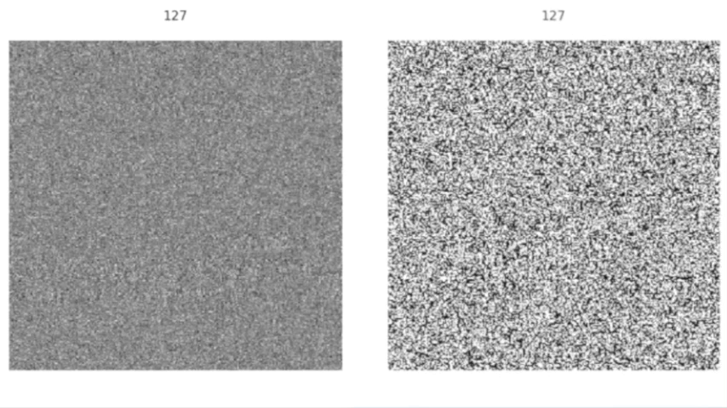
Vanishing and Exploding Gradient
Long-term memory of RNNs suffers due to uncontrolled gradients
Additional mechanisms are used to optimize memory and sensitivity (details in Lab 6)
Gated architectures – LSTM, GRU
Constrained-weight RNNs
Notes:
The standard (or vanilla) RNN that we have discussed today has difficulty learning long-term dependencies because of these issues.
Various architectural modifications have been introduced to enhance the memory of the RNN and constrain its gradients. These will be covered in more detail in Lab 6, but I will briefly introduce them today.
The first is gating mechanisms, such as the LSTM and GRU, which use specialized gates to learn how long information should be retained.
The second approach uses constraints on the weights of the RNNs to ensure information propagates in the desired way. Examples include orthogonal, antisymmetric, and non-normal RNNs.

Slide 28
Sensitivity to Initialization
RNN performance can be very sensitive to initialization
Optimal initialization distribution depends on:
Hidden size
Non-linearity
Input statistics
Notes:
It has been shown that the initialization of an RNN can have significant effects on its performance, and that these networks are particularly sensitive to initialization.
There are many factors which influence the optimal choice of initialization, including the hidden size of the RNN, the non-linearity used, and the statistics of the input data

Slide 29
Initialization Distributions in PyTorch
torch.nn.init
Uniform
Normal
Xavier Uniform
Xavier Normal
Kaiming Uniform
Kaiming Normal
Orthogonal
Notes:
In Torch, there is a large number of built-in initialization distributions. The fundamental distributions are Uniform and Normal. However, there are variations on these distributions such as Xavier and Kaiming which alter the parameters of these distributions based on the dimensions of the input and output of the RNN.
For more details about each of these distributions, I recommend you check out torch.nn.init
Which distribution you choose for your network will depend on the input data and task.

Slide 30
Example: Sine Wave Generation
Adapted this tutorial: https://lirnli.wordpress.com/2017/09/01/simple-pytorch-rnn-examples/
Notes:
I will briefly go over an example of RNN training. The task will be to propagate a sine wave given a short sample of that sine wave signal.

Slide 31
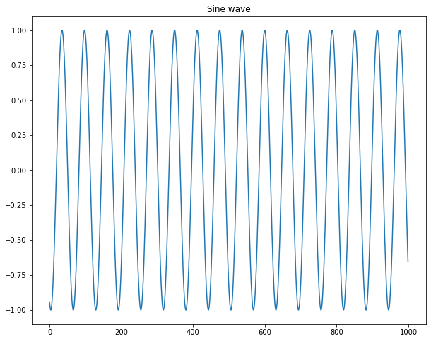
Problem setup
Sine wave with random shift as input
Want to predict the next time step given an input sequence
Notes:
For this problem, the input data will come in the form of randomly-generated sine waves (with amplitude 1) and random horizontal shifts.
Given an input signal, predict what the next value will be. Then iterate for each following step for a set amount of time.

Slide 32
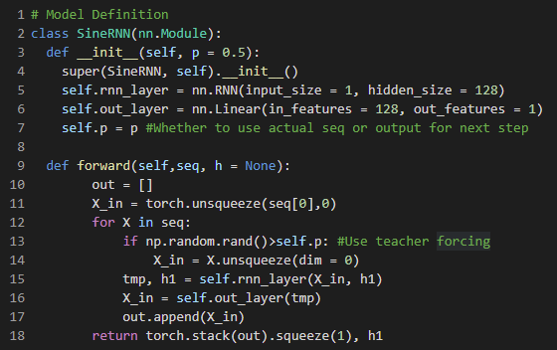
Model Definition
Using RNN with hidden size 128
Use linear layer for output
Teacher forcing to help guide network with true values
hybrid one-to-many/many-to-many problem
Notes:
Here is the code defining the RNN model used.
We use a single-layer RNN to generate an output h. This output is then fed into a fully connected layer to predict the next value (which is 1D)
At each time step, we use Teacher Forcing, which allows long-term predictions to be “corrected” by the true value.
We will describe this in more detail on the next slide

Slide 33
Teacher Forcing
When predicting a sequence from an input sequence, you can use “teacher forcing”
Randomly select either:
Actual input (teacher) value
Output of network at previous step (prediction)
Actual Input
RNN Model
Previous Predicted Value
Teacher Forcing
Notes:
Teacher forcing is a mechanism used to correct predictions made in a long sequence.
With some random probability, you either use the output of the network at the previous time step as input, or you use the actual value of the input data as input, which serves as a teacher.
This allows the network to randomly correct predictions in case it makes errors which propagate forward. This can help with learning by allowing faster convergence.

Slide 34
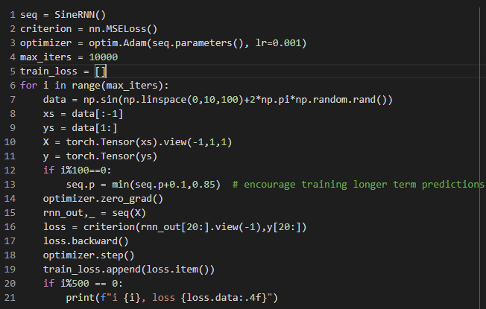
Training
Generate data:
Sine waves with random shifts
Both input and targets (shifted 1)
Increase chance of using past predictions
Warm-up for 20 steps and then evaluate loss
Notes:
To train this network, we use the Adam optimizer and MSE loss. We generate sine waves with 100 steps and random shifts, and train for 10000 iterations. (Note that this data is not the most efficient way to generate this training set. How could you make it better? Does this allow parallelization across batches?)
These sine waves act as both the input and the targets, but they are shifted by 1 relative to each other.
Partway through training, we can update how often we use teacher forcing to encourage the network to predict longer sequences on its own.

Slide 35
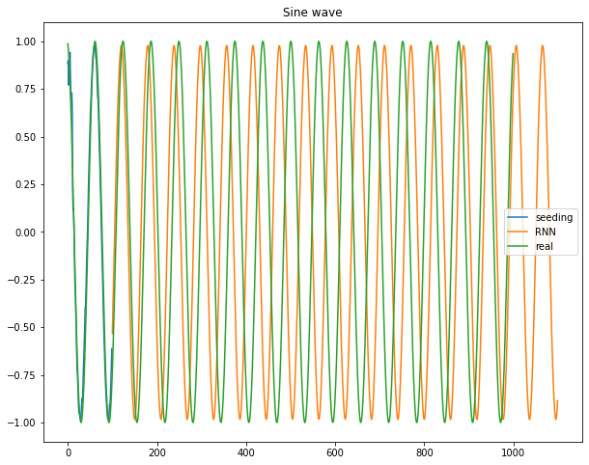
Results- Predictions
First 100 steps as seed
Predict for 1000 steps
Able to capture general shape, but makes errors finding period (requires long memory)
Total MSE Loss: 0.9695
Notes:
Here we show the predictions after training. We generate longer sequences for prediction to see how well the network can predict these long values. We allow the network to have teacher forcing for the first 100 steps (seed) before it predicts on its own for the steps after that. As you can see, it is able to capture the general shape of the sine wave, but the period is too short. Learning the correct period of the sine waves requires somewhat long memory.

Slide 36
Assignment: Cosine Wave Generation
Notes:
You will now extend this example to similarly generate cosine waves.

Slide 37
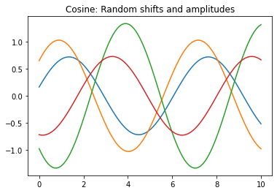
Assignment Details
Create an RNN model to generate cosines like in example
Use random shifts as in example
Generate samples with different amplitudes, ranging from 0.5 to 1.5 (How much data do you need?)
Play with hyperparameters of your network
Notes:
Like the example, you will generate cosines as your data and train your network to propagate these cosines forward in time.
Use random shifts like in the example. In addition, you should randomly vary the amplitude of your cosine waves between 0.5 and 1.5.
Note that having two properties of your data varying means you will need considerably more training data. Think about how much you should use to properly explore this space.
Choose your network hyperparameters to find optimal performance (it is okay for your network not to work perfectly. Explore!)

Slide 38
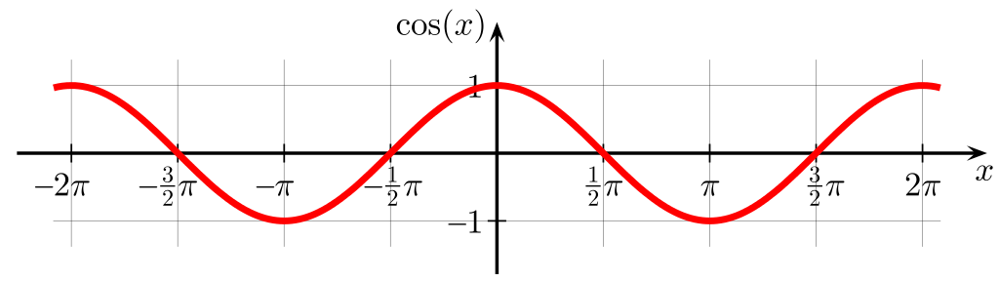
Evaluation
Generate a validation/test set of 1000 randomly-generated cosines
Find MSE loss on this validation set
Plot your best and worst predictions in the validation set
Notes:
To evaluate your networks, generate a validation/test set of 1000 randomly-generated cosines of length 1000.
Measure the MSE loss on this validation set.
Plot your best and worst predictions on the validation set and describe what the network was good and bad a capturing in the data

Slide 39
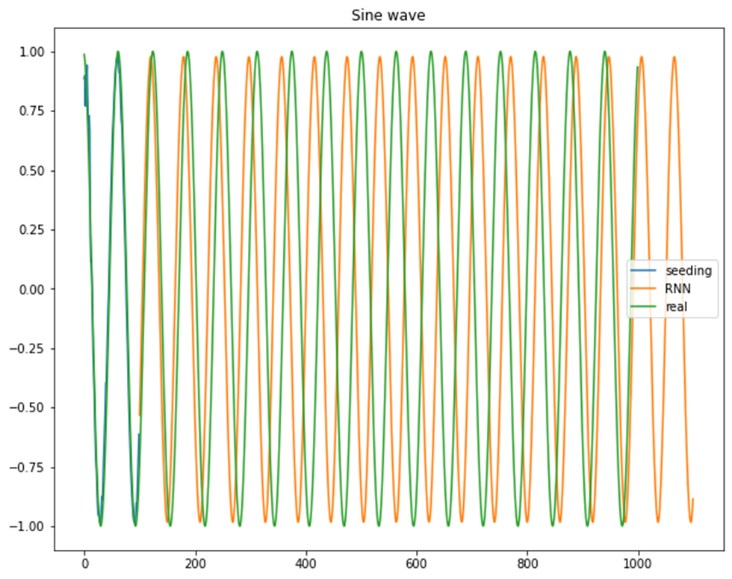
Evaluation Detail
For validation set, create longer sequences (1000 steps)
Evaluate loss after a warm-up period of 100 steps
Only calculate loss where prediction and real input overlap
Notes:
When generating predictions on your validation set, these should be long sequences. Like in the example, allow the network to warm up for about 100 steps using the actual input data as input. After that, have the network use only its previous output as input (one step at a time)
Calculate the MSE loss only where the network predictions and real input overlap (between time steps 100-1000)

